Slide 1

Cost Reduction Strategies
Presented by Santosh Gupta

Slide 2




Problems
Rising Operational Costs
Increasing expenses in day-to-day operations. Higher expenditures on resources, services, or activities.
Inefficient Processes
Operational workflows that are not optimized. Wasteful or redundant steps leading to inefficiencies.
Competitive Pressures
External factors compelling a focus on cost efficiency.
Highlights of challenges or issues that the organization is currently facing, which could benefit from the implementation of cost reduction strategies. Here are three potential points

Slide 3

Solutions
Actionable steps and initiatives that can be implemented to address the identified challenges.
Automation |  | Trainings |  | Many More..
Optimize existing processes |  | Implement cross-training initiatives to create a versatile workforce |  | Lets explore more..

Slide 4

Automation
Robotic Process Automation (RPA)
  Utilizing technology to automate repetitive tasks, reducing labor costs, and boosting operational efficiency. Enhances productivity and accuracy across various processes. Robotic Process Automation (RPA)

Slide 5

Employee Training
01 | Skill Enhancement
 | Continuous training programs to enhance employees' skills and capabilities.
02 | Efficiency and Productivity
 | Investing in training to boost efficiency and overall workforce productivity.
03 | Adaptability and Innovation
 | Fostering a culture of learning to ensure adaptability and encourage innovative solutions.

Slide 6
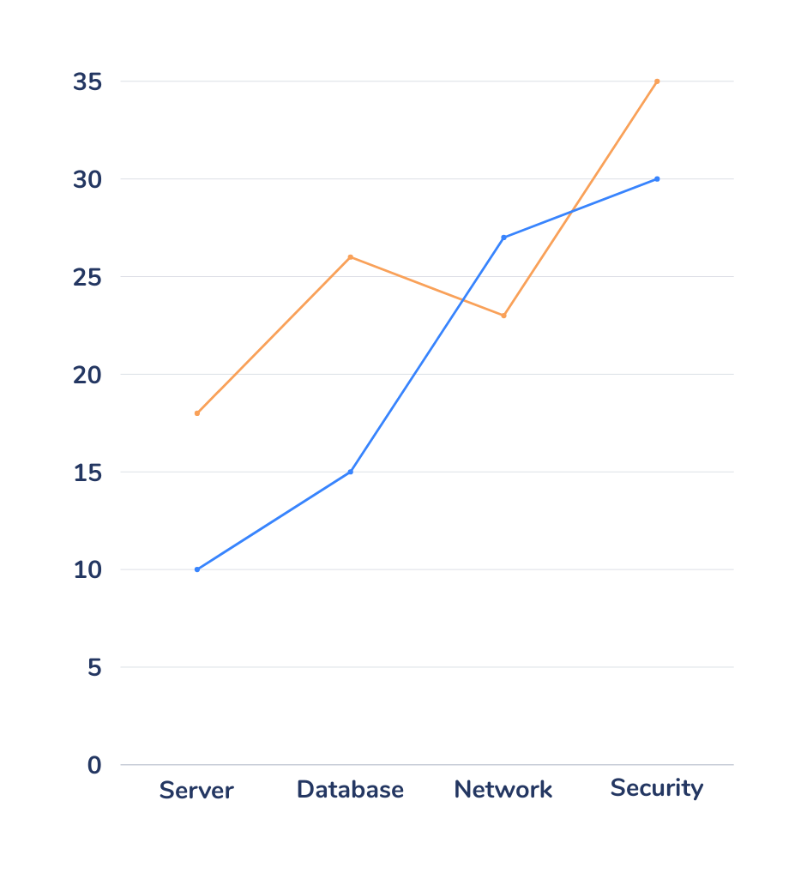


Technology Upgrades
This is where we are now in terms of number of users and company growth

Slide 7


Supply Chain Optimization
Inventory Management Efficiency
Inventory Management Portal
Streamlining supply chain processes to optimize inventory management.
The portal provides real-time visibility into current stock levels.

Slide 8

Energy Efficiency
Display Power Management
IMPLEMENTING SCREEN TIMEOUT SETTINGS TO AUTOMATICALLY TURN OFF THE DISPLAY AFTER A PERIOD OF INACTIVITY.
PC Hardware Optimization
IMPLEMENTING ENERGY-EFFICIENT HARDWARE COMPONENTS, SUCH AS LOW-POWER PROCESSORS, ENERGY-EFFICIENT GRAPHICS CARDS, AND SOLID-STATE DRIVES (SSDS).
MARKET SHARE

Slide 9



Cost Benchmarking
  Evaluating the costs of IT hardware devices, such as servers, laptops, and networking equipment, in comparison to industry benchmarks.
  Analyzing pricing structures, vendor negotiations, and technology specifications to ensure the organization's IT hardware costs align with industry standards.

Slide 10



